Slide 1

Predicting the Popularity of TED Talks with Statistical Analysis
Zeheng Lin, Junbo Li, Xiaowen Zhang, Mengyao Liu, Haoming Wang

Slide 2
Overview
Introduction
Methodology
Results
Conclusions
References

Slide 3
Background
TED Conferences LLC (Technology, Entertainment, Design) is a nonprofit media organization that posts short talks online for free distribution under the slogan “ideas worth spreading”. It was initiated in 1984 by Richard Saul Wurman as a conference and has become held annually since 1990. Despite its early emphasis on design and technology, TED now include talks on various topics, including science, culture, and academia.

Slide 4
Introduction
INTRODUCTION | METHODOLOGY | RESULTS | CONCLUSIONS
This research study uses inferential techniques of data analysis, aiming to investigate various approaches, other than simply view counts, to quantify the popularity of TED talks.

Slide 5
Methodology - Define Research Questions
INTRODUCTION | METHODOLOGY | RESULTS | CONCLUSIONS
What characteristics of TED Talks predict their popularity?
Occupation
Tags
Number of Speaker
Do the characteristics that predict popularity change over time?
Talks before 2010
Talks between 2010 - 2014
Talks after 2014

Slide 6
Methodology - Data Analysis with R
INTRODUCTION | METHODOLOGY | RESULTS | CONCLUSIONS
Grouping keywords into positive and negative category.
Positive: Informative, Inspiring, Fascinating, Ingenious, Beautiful, etc.
Negative: Unconvincing, Confusing, Obnoxious, Longwinded, etc.
Analyzing the impact of occupation, tags, and number of speaker on the popularity of TED talks using R.
Grouping TED talks into three categories based on the time and compare the tags associated with “best” and “worst” TED talks.

Slide 7
Results
INTRODUCTION | METHODOLOGY | RESULTS | CONCLUSIONS
What characteristics of TED Talks predict their popularity?

Slide 8
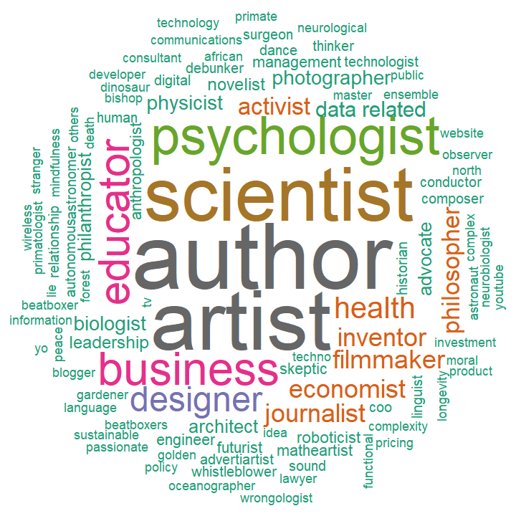
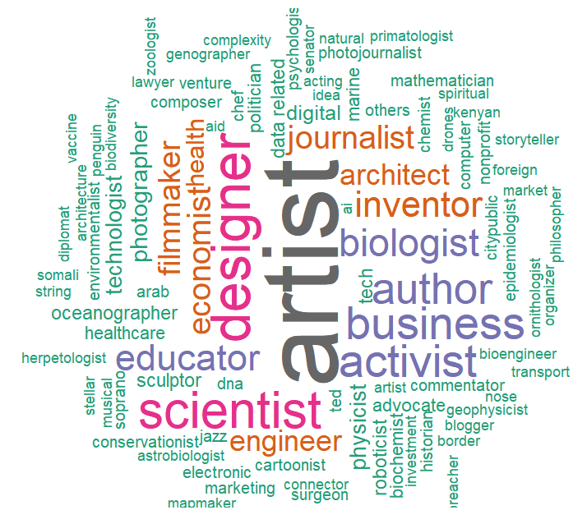
Results - Occupation
INTRODUCTION | METHODOLOGY | RESULTS | CONCLUSIONS
BEST
WORST

Slide 9
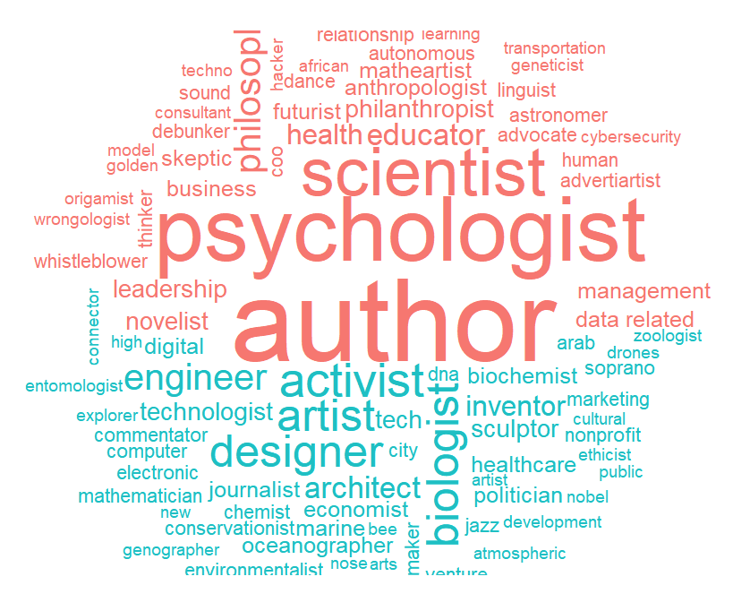
Results - Occupation
INTRODUCTION | METHODOLOGY | RESULTS | CONCLUSIONS
Some occupations show up in both “best” and “worst” figures.
Psychologist is generally associated with more popular talks while activist is associated with less popular talks.
Occupation does not have a significant impact on the popularity of talks.

Slide 10
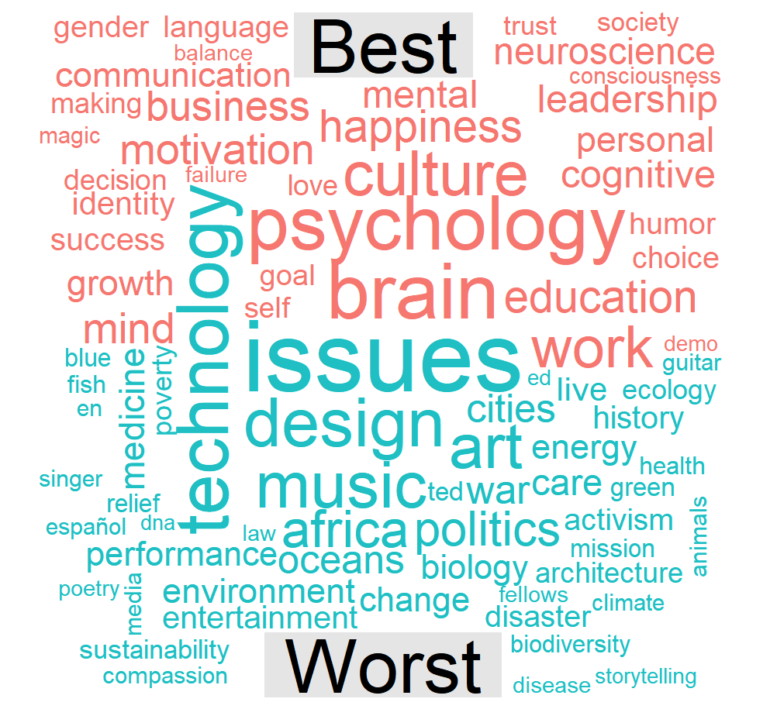
Results - Tags
INTRODUCTION | METHODOLOGY | RESULTS | CONCLUSIONS
“Best” talks typically have positive and affirming tags, such as happiness, success, humor, growth, etc.
“Worst” talks typically have negative or sensitive tags, such as war, Africa, politics, disaster, etc.
Tags are strongly related to the popularity of the talks.

Slide 11
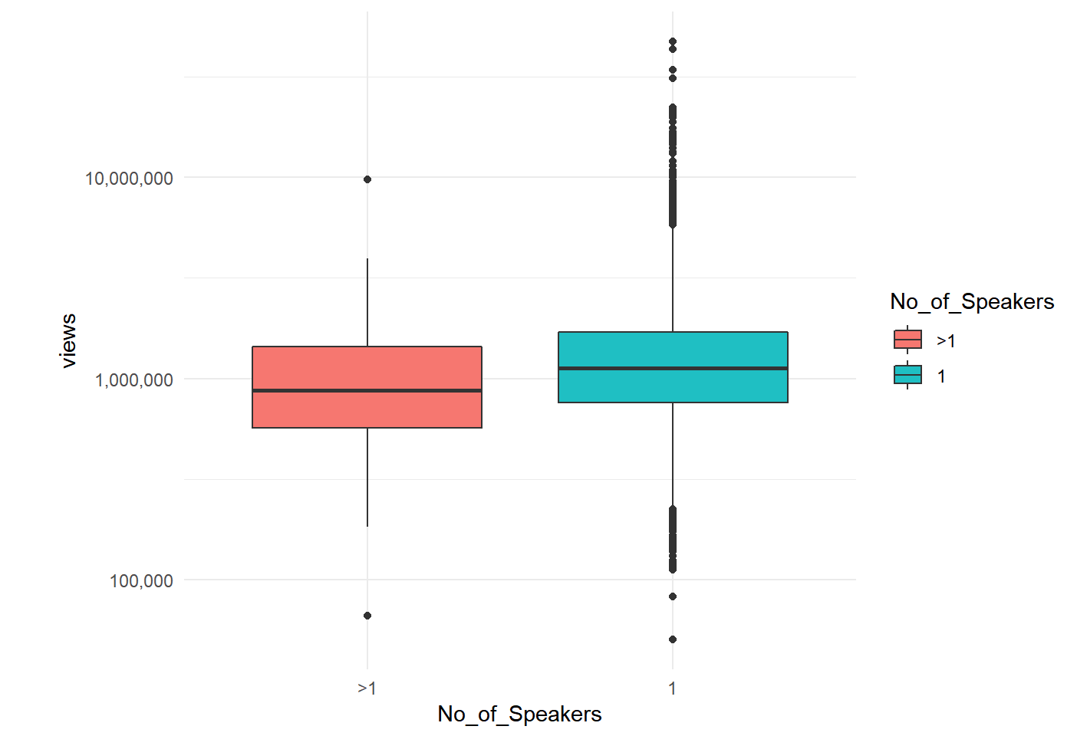
Results - Number of Speaker
INTRODUCTION | METHODOLOGY | RESULTS | CONCLUSIONS
Talks with one speaker is more popular than talks with two or more speakers in general.
Possible reasons:
Less distraction, especially when switching from one presenter to the other.
Single-speaker talks typically have one single theme/point with more in-depth analysis.

Slide 12
Results
INTRODUCTION | METHODOLOGY | RESULTS | CONCLUSIONS
Do the characteristics that predict popularity change over time?

Slide 13
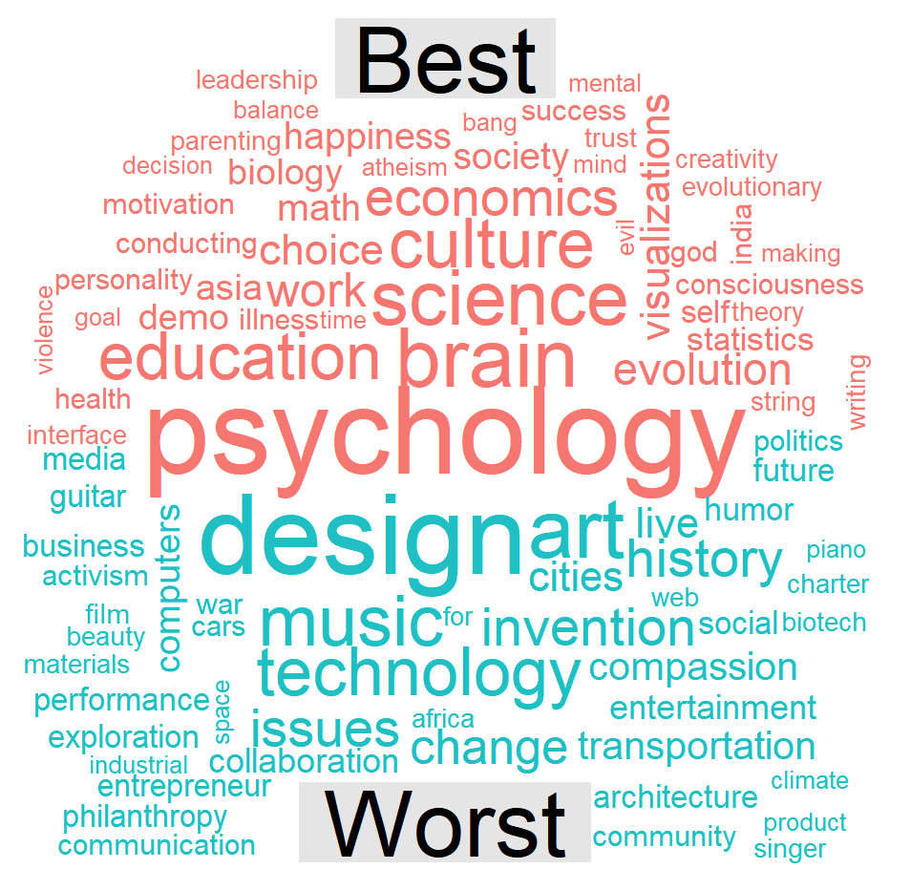
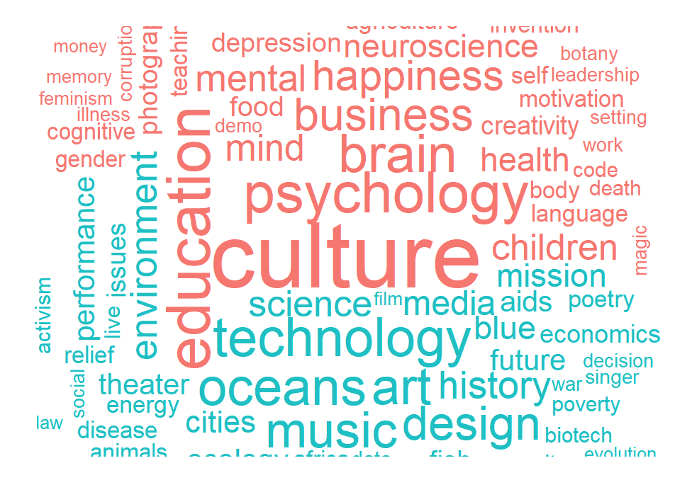
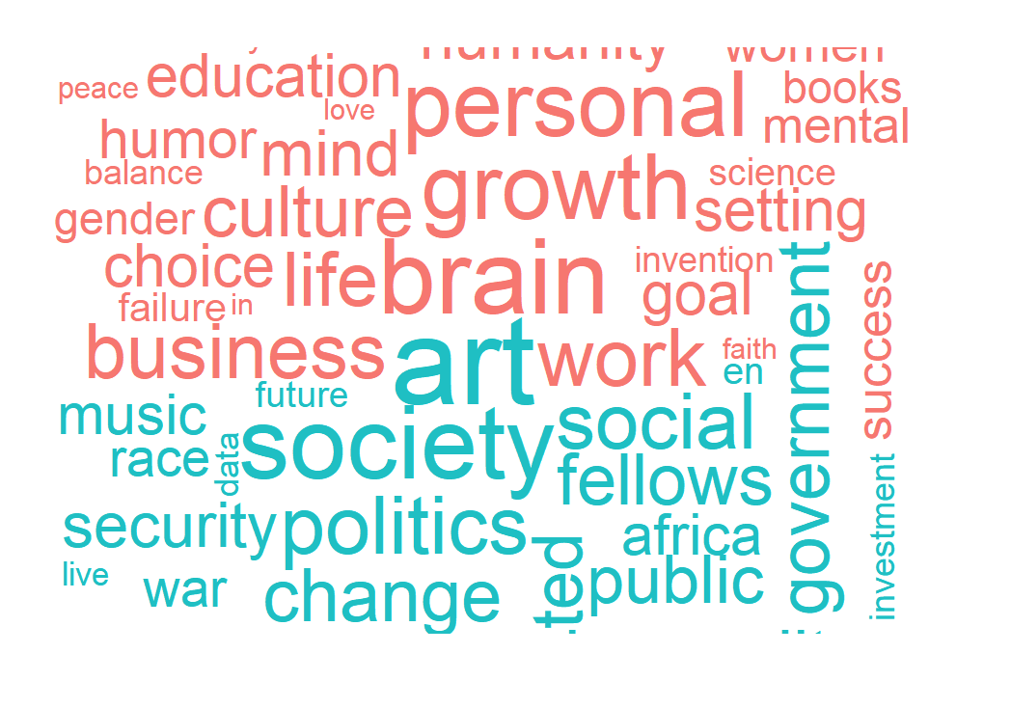
Results - Time of Talks (Comparisons)
INTRODUCTION | METHODOLOGY | RESULTS | CONCLUSIONS
Before 2010
2010 - 2014
After 2014

Slide 14
Results - Time of Talks
INTRODUCTION | METHODOLOGY | RESULTS | CONCLUSIONS
Characteristics that predict popularity have changed over time.
Possible reasons:
Change in audience’s preferences.

Slide 15
Conclusions
INTRODUCTION | METHODOLOGY | RESULTS | CONCLUSIONS
Speaker occupation does not have a significant impact on the popularity of TED Talks.
Tags and number of speakers both have a significant impact on the popularity of TED talks.
The characteristics that predict popularity of TED talks have changed substantially over time, mainly due to the change in audience’s preferences.

Slide 16
References
Wikipedia contributors. (2018, November 27). TED (conference). In Wikipedia, The Free Encyclopedia. Retrieved 04:12, November 30, 2018, from https://en.wikipedia.org/w/index.php?title=TED_(conference)&oldid=870848295
TED: Ideas worth spreading. (n.d.). Retrieved November 29, 2018, from https://www.ted.com/

Slide 17
THANK YOU!

